Slide 1
DO for WS DO for WML Hands-on Marketing Campaign
Alain Chabrier
alain.chabrier@ibm.com
Updated Aug 2019

Slide 2
Summary
Decision Optimization adds prescriptive analytics capabilities to IBM Watson Studio and IBM Watson Machine Learning.
This hand-on is created around a very simple Marketing Campaign problem.
It will introduce you thought all the steps necessary in order to use of Decision Optimization for Watson Studio and Decision Optimization for Watson Machine Learning.
This is a Public Cloud version of the Hands On, another version is available for Watson Studio Local.

Slide 3
Pre-requisites
You need some working access to Watson Studio (Cloud) including to the Decision Optimization Model Builder Beta:
→ https://dataplatform.cloud.ibm.com
All material you need (data, working notebooks, etc) is included in:
→ https://github.com/IBMDecisionOptimization/DO4WS-MarketingCampaigns-HandsOn

Slide 4
Problem description

Slide 5











Marketing Campaign Optimization
Which product/campaign ?
Through which channel?
To which customers?
Notes:
Problem Description
During all the labs we will use a common business problem.
Let’s suppose a bank can run different marketing campaign(s) to offer additional product(s) to existing customer(s).
Depending on customer characteristics, the success and revenue to be expected of executing a given campaign may change.
Depending on the campaign, different costs and limits may apply.
The bank can use Machine Learning (ML) models to predict the response of customer according to their characteristics. The model can be trained using historical data.
The bank can use Decision Optimization (DO) models to select which campaign to propose to which customer to reach the optimal overall expected revenue

Slide 6
Marketing Campaign Assignment
Customers | Home | Auto | Travel
1 | $70 | $60 | $60
2 | $80 | $80 | $70
3 | $90 | $90 | $80
4 | $50 | $50 | $50
5 | $100 | $100 | $100
6 | $110 | $130 | $150
7 | $20 | $20 | $90
8 | $10 | $40 | $80
9 | $0 | $50 | $60
10 | $40 | $40 | $80
Easy without constraints.

Slide 7
Marketing Campaign Assignment
Customers | Home | Auto | Travel
1 | $70 | $60 | $60
2 | $80 | $80 | $70
3 | $90 | $90 | $80
4 | $50 | $50 | $50
5 | $100 | $100 | $100
6 | $110 | $130 | $150
7 | $20 | $20 | $90
8 | $10 | $40 | $80
9 | $0 | $50 | $60
10 | $40 | $40 | $80
Just run them all!

Slide 8
Marketing Campaign Assignment
Customers | Home | Auto | Travel
1 | $70 | $60 | $60
2 | $80 | $80 | $70
3 | $90 | $90 | $80
4 | $50 | $50 | $50
5 | $100 | $100 | $100
6 | $110 | $130 | $150
7 | $20 | $20 | $90
8 | $10 | $40 | $80
9 | $0 | $50 | $60
10 | $40 | $40 | $80
Real life constraints and objectives:
Avoid customer burnout: at most one campaign per customer
Capacity: at most three customers per campaign

Slide 9
Marketing Campaign Assignment
Customers | Home | Auto | Travel
1 | $70 | $60 | $60
2 | $80 | $80 | $70
3 | $90 | $90 | $80
4 | $50 | $50 | $50
5 | $100 | $100 | $100
6 | $110 | $130 | $150
7 | $20 | $20 | $90
8 | $10 | $40 | $80
9 | $0 | $50 | $60
10 | $40 | $40 | $80
Best total score is: 770

Slide 10
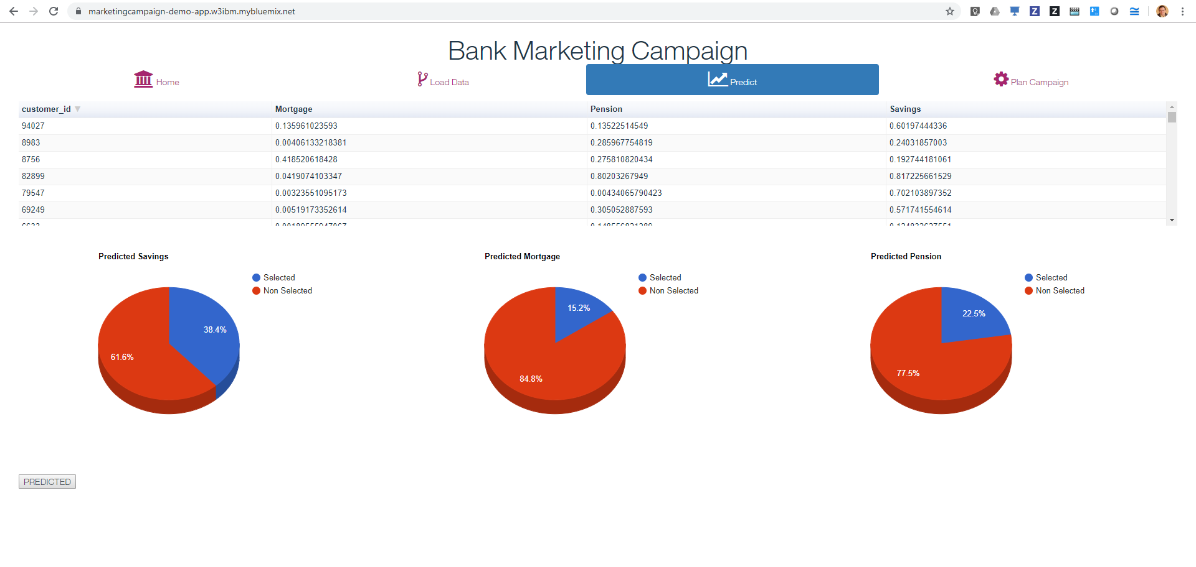
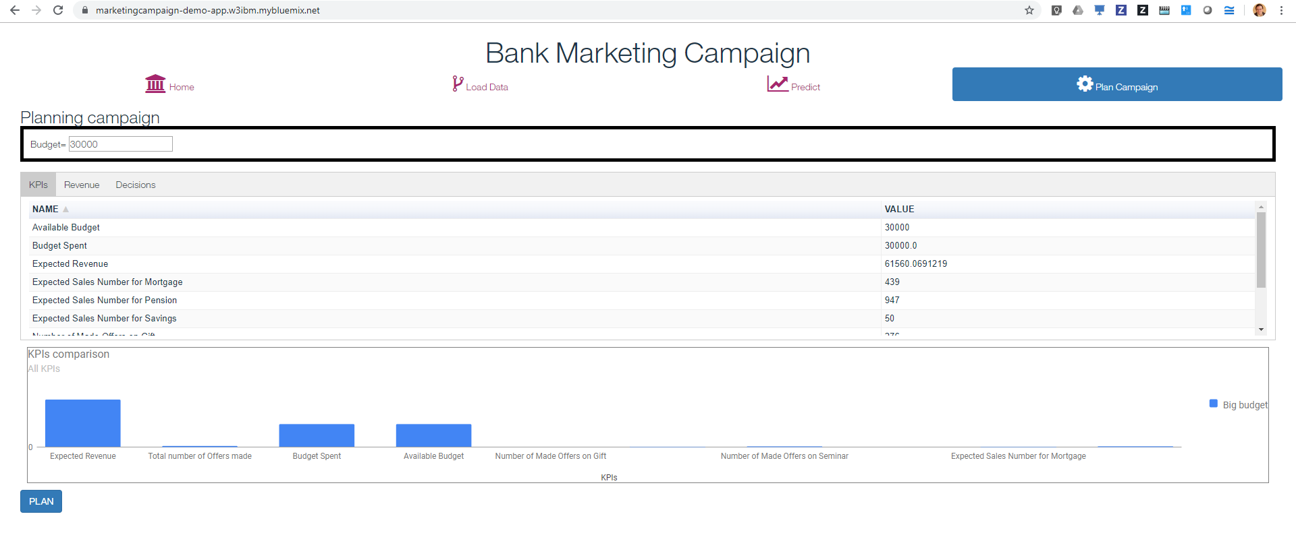
Objective: Marketing Campaign Web Application
https://marketingcampaign-demo-app.w3ibm.mybluemix.net/

Slide 11
Decision Optimization Models lifecycle
Formulate model
Test/debug model
Validate model
Develop
Deploy
Create model (in WML)
Upload model files
Deploy model
Submit job
(Inline data)
Poll job status
(inline results)
Delete job
Upload data
Use
Download results

Slide 12
Decision Optimization Experiences
Formulate and solve models in notebooks, using known tools and combine with other techniques.
Use dedicated Model Builder to better debug, tune and validate models using Scenarios and Visualizations.
Formulate models without Mathematical skills using Natural Language modeling assistant.
Develop
Python
Notebooks
Model Builder
Modeling Assistant
Other Python packages
Model Builder
Python
OPL
Natural Language
Scenarios
Visualizations
Deploy
Deploy models from Python.
Deploy models using REST API.
Deploy models from UI.
Python
Notebooks
REST APIs
Model Deployment
Model Deployment
Model Deployment
Execute and monitor models using Python.
Execute and monitor models integrated in custom applications.
Execute and monitor models integrated in Planning Analytics.
Use
Python
Notebooks
Node JS
Planning Analytics
Create Jobs
Monitor
Create Jobs
Monitor
Create Jobs
Monitor

Slide 13
Content
In this hands-on, you will:
log in WS and play with an sample notebook combining ML and DO,
create and deploy the predictive models using Auto AI,
create a new simple optimization model using a Python notebook,
use model builder to import, run, and debug this optimization model,
use Python to create many scenarios and do what-if
create an equivalent model using the modeling assistant.
deploy the optimization model into WML
integrate into a sample nodejs application
Steps in italic are optional and not required for the end to end understanding.

Slide 14
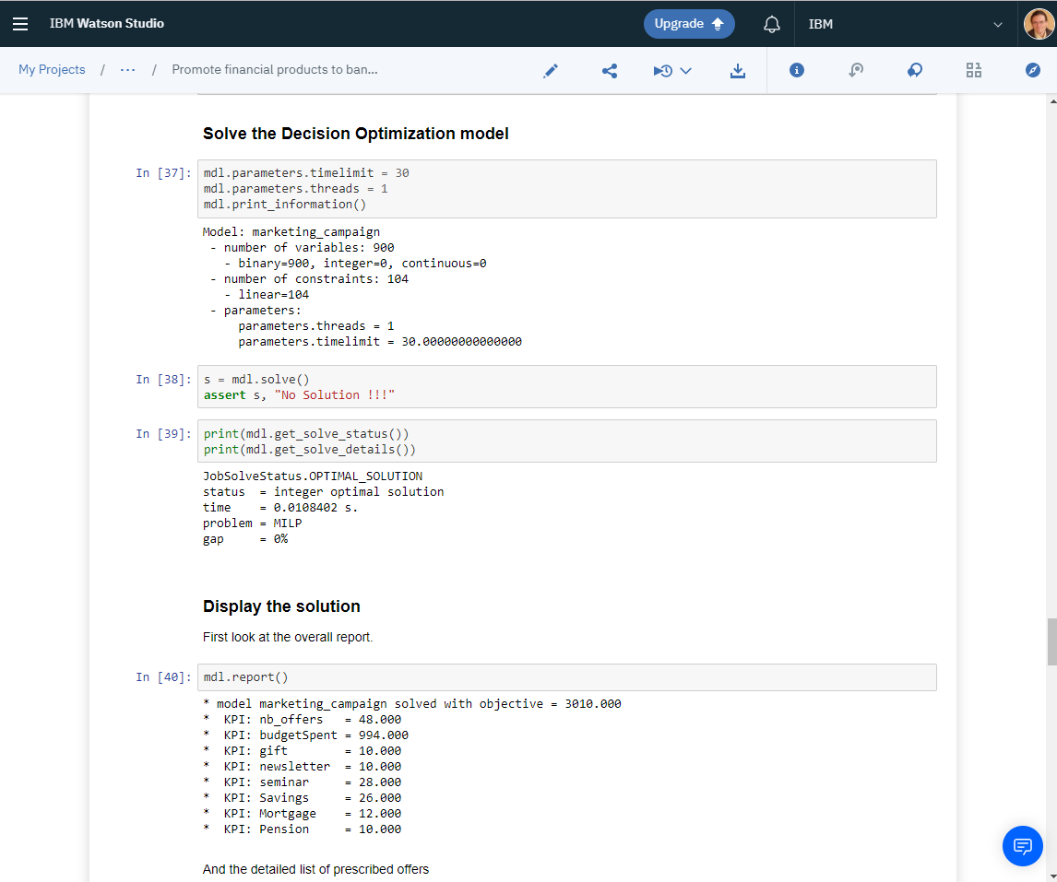
1- Explore a working example
Predictive models returns how likely some customer would react to a given campaign on a given channel. Prescriptive models returns the best set of assignment customer-campaign-channel to optimize the total benefit and taking into account large number of constraints. Decision Optimization quickly outperforms manual assignment. Decision Optimization enables multi-scenario analysis.

Slide 15
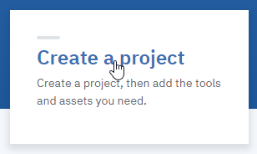
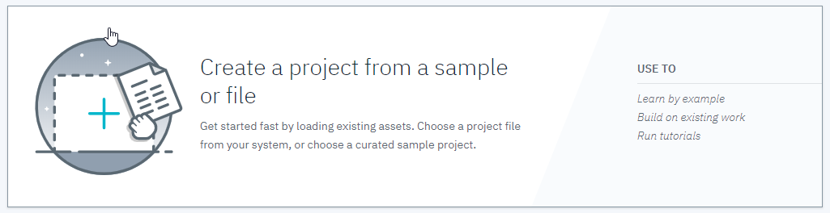
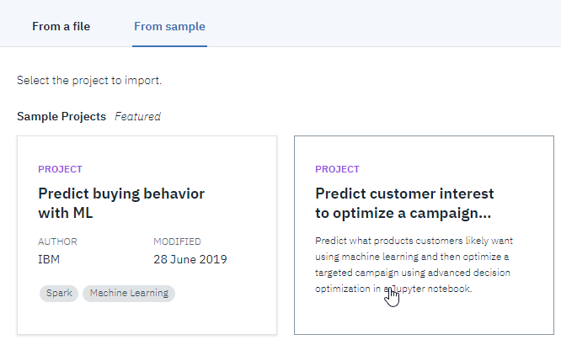
Step 1 Tips.
In Watson Studio,
Create a new project
Choose ‘from a sample or file’
Choose the ML + DO sample
Open project and notebook
Go through it optionally running cells
(BIG DATA SET requires specific DO environment)

Slide 16
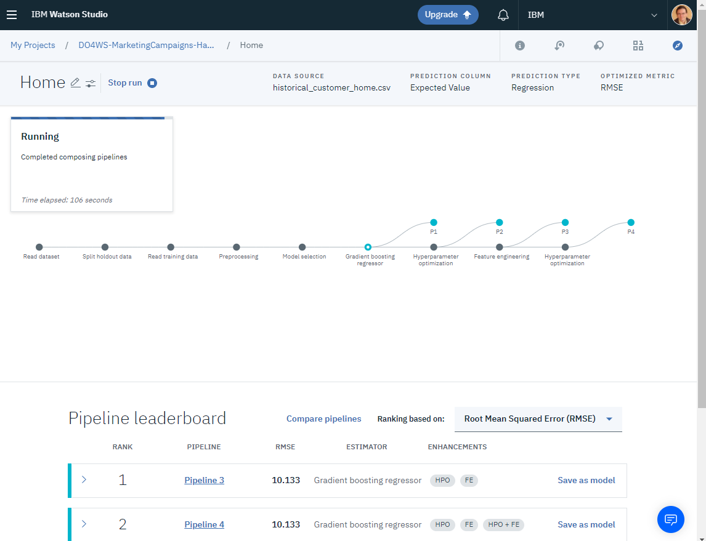

2. Train and Deploy Predictive Model
Objectives
The next step is to create, train and deploy a predictive model for each of the campaign you want to predict customer expected value.
New Auto AI feature allows you to create and train a predictive model without writing any code.

Slide 17
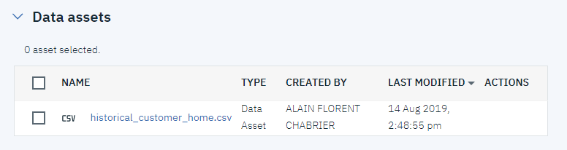
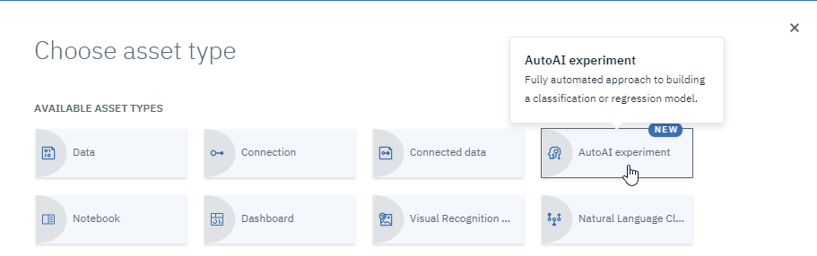
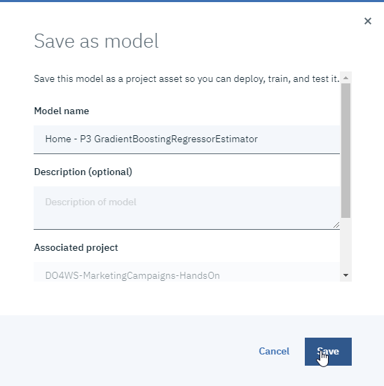
Step 2 Tips.
Add historical customer home csv data to project
Create a new Auto AI Experiment
Select the uploaded data asset
Select the ‘Expected Value ‘ column to be predicted
And let AutoAI work
Save the best model to the project

Slide 18
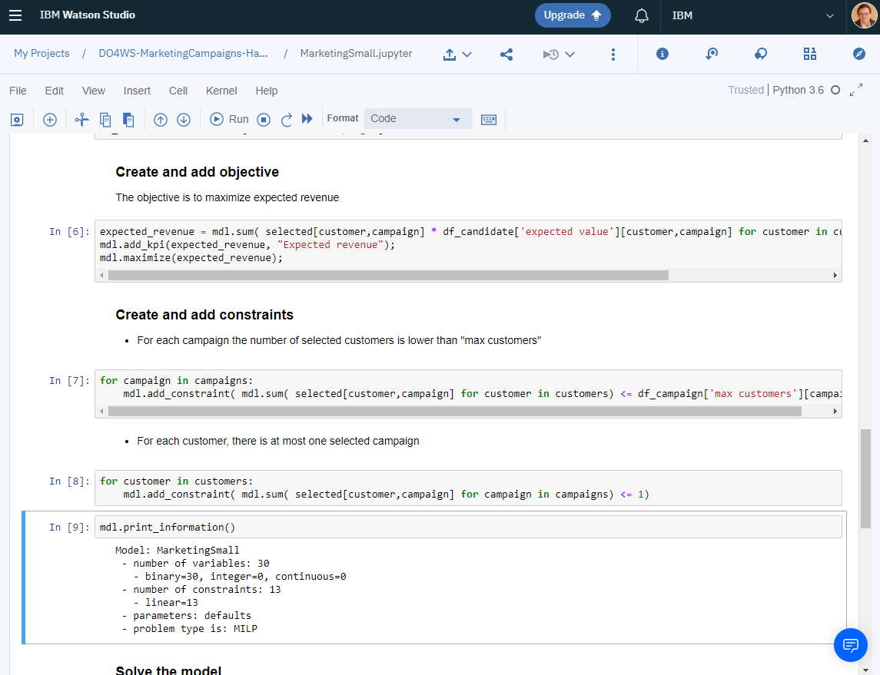
3. Create an optimization model in a notebook
Objectives
The next important step is to formulate the Decision Optimization model. In DO for WS, models are mainly formulated with Python or OPL.
Python notebook allows to develop a model using docplex API which can be later imported into the DO for WS model builder to benefit from multiple scenarios, dashboards and model deployment.

Slide 19
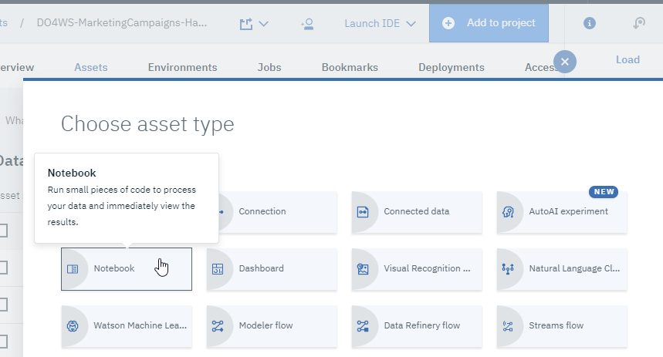
Step 3 tips.
Upload csv data in the project
Create a new notebook:
Use docplex API: https://cdn.rawgit.com/IBMDecisionOptimization/docplex-doc/master/docs/index.html
Look at examples notebooks in the community.
Solution in “MarketingSmall” notebook.

Slide 20
Formulate the optimization problem : the Python model
Import data
Create container for the model
Define the decision variables
Set up the constraints:
Offer only one product per customer.
Max customer per campaign
Express the objective:
We want to maximize the expected revenue

Slide 21

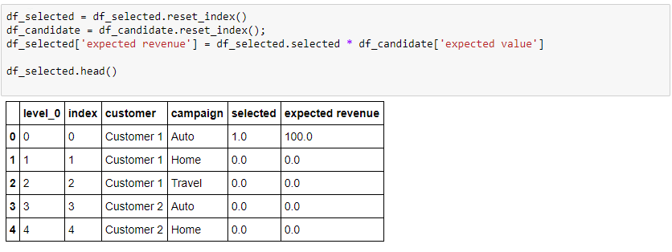
Solve the Optimization model
Solve the model
Solve returns:
some status information,
the value of objective
Update data frame with values for decisions, which are retrieved from ‘solution’ object

Slide 22
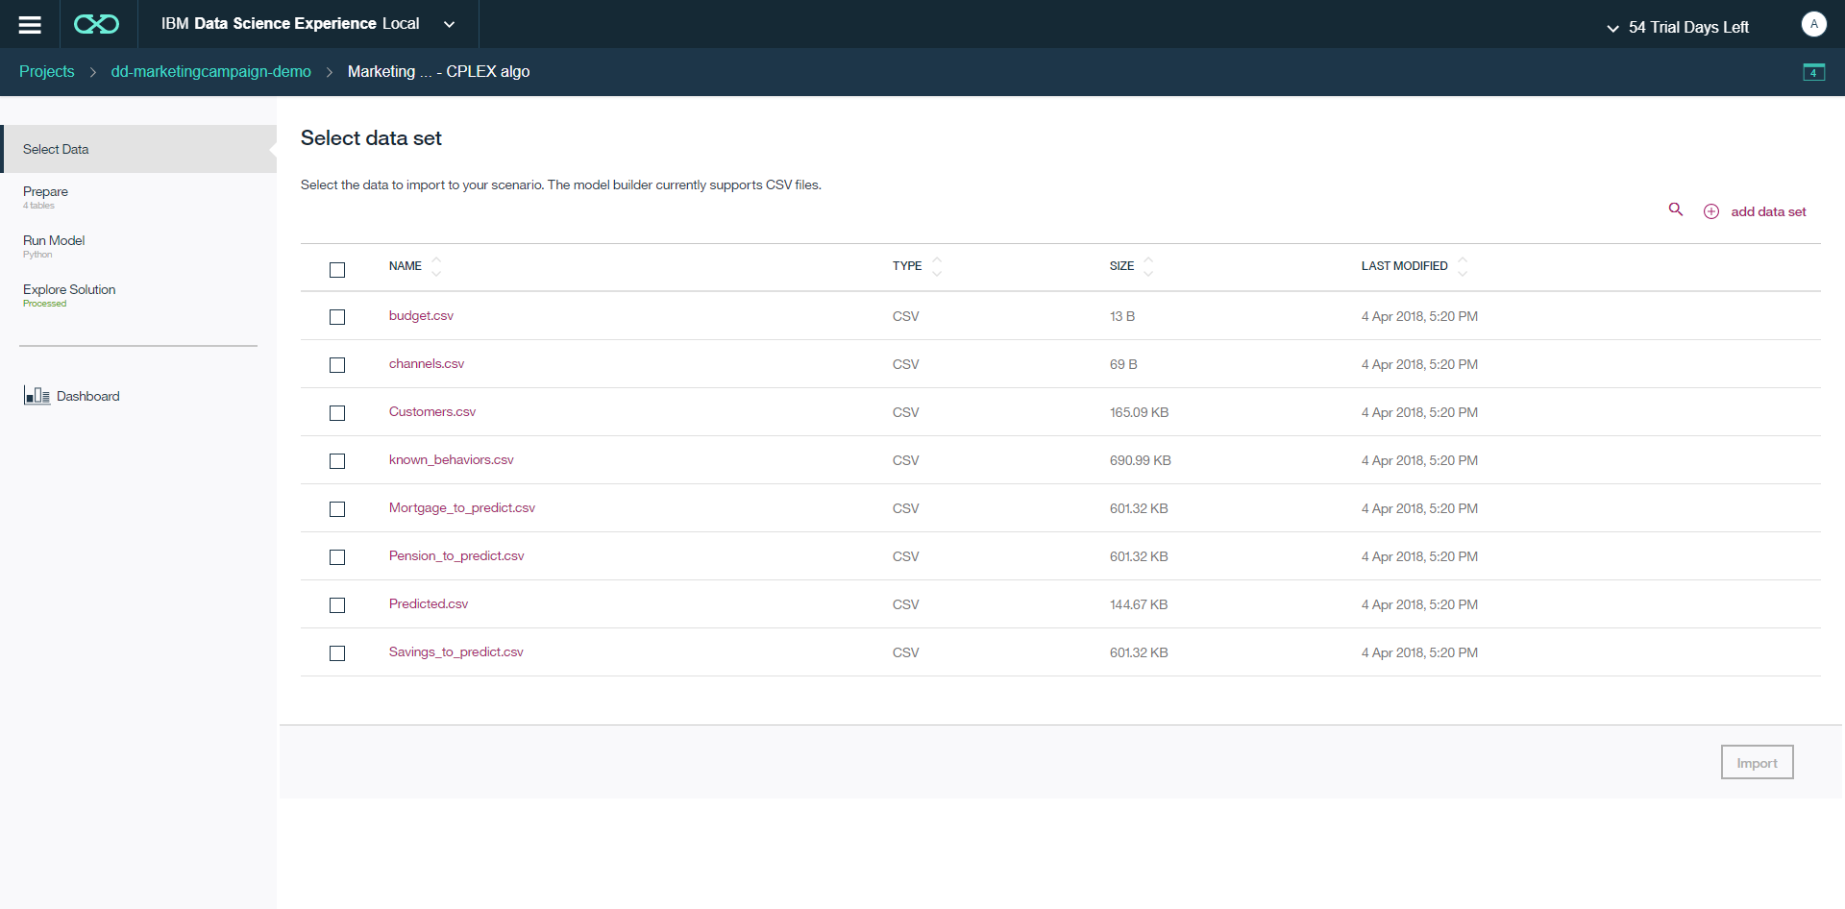
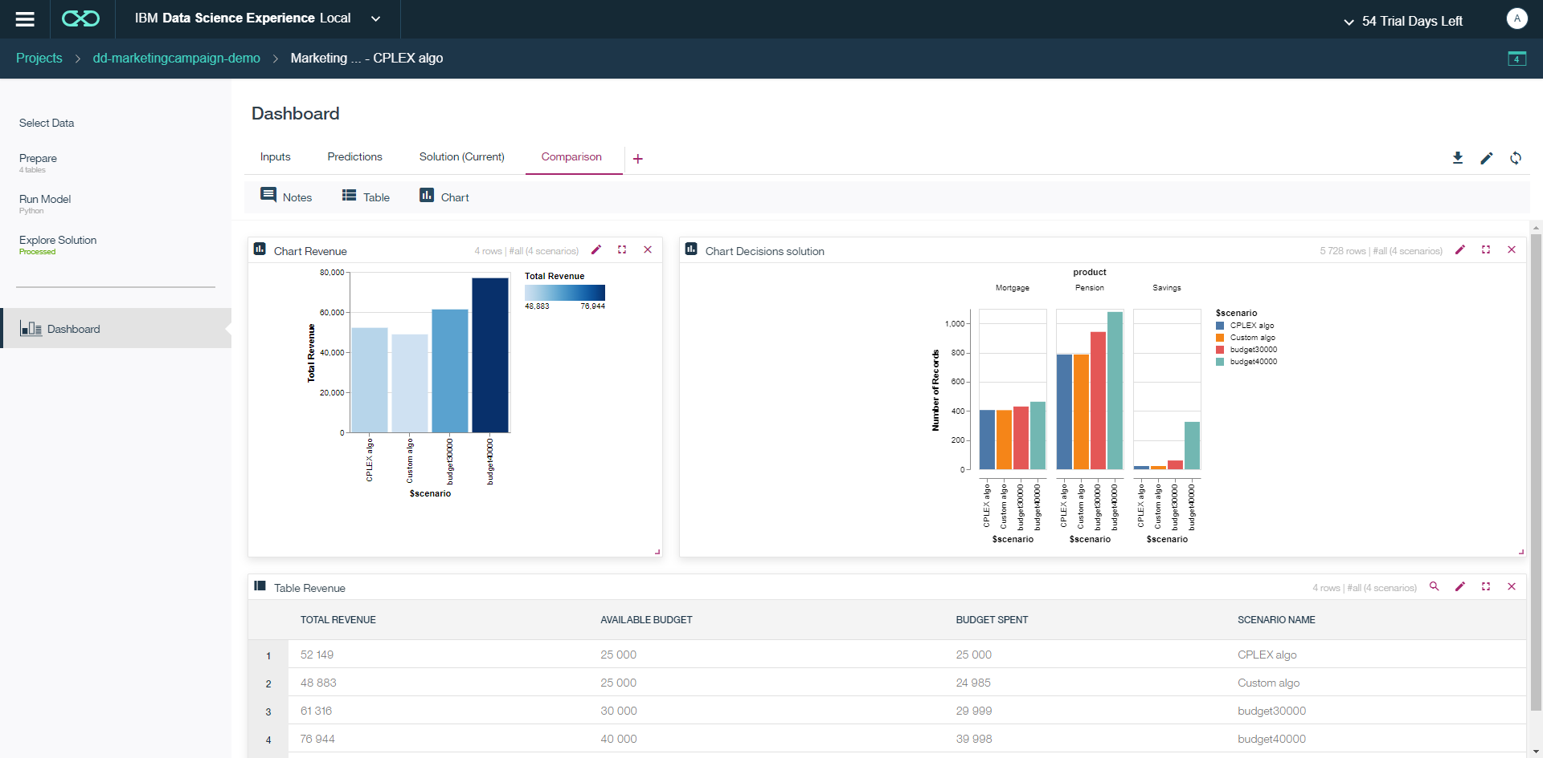
4. Use DO model builder and dashboard
Objectives
In DO for WS, a specific model builder allows you to organize the different scenarios with their input data and their model formulation. Some visualization makes it possible to easily layout out the different graphical widgets that will allow the Business Analyst to validate the solution over different scenarios.

Slide 23
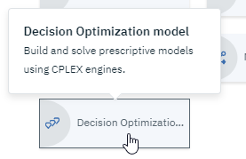
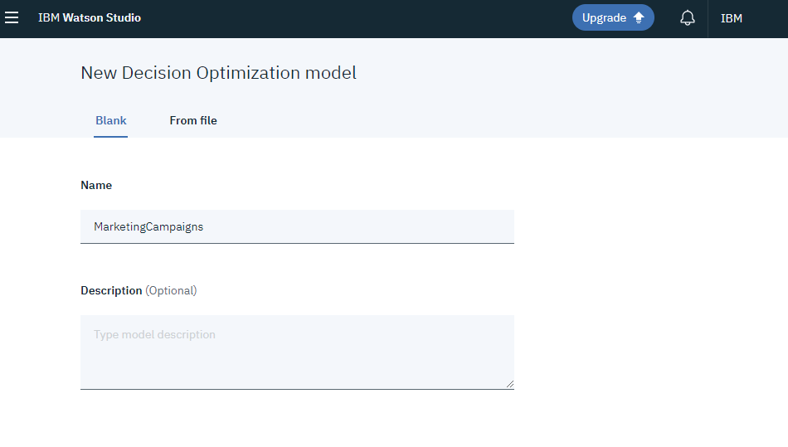
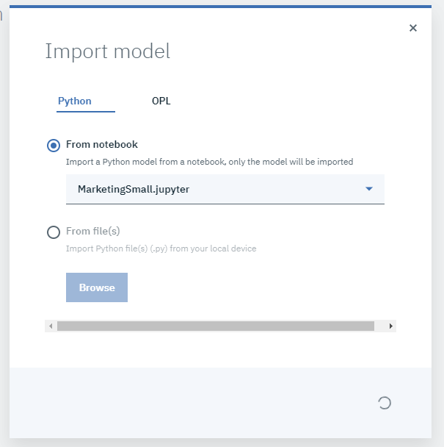
Step 4 tips.
Create a new Decision Optimization model
In ‘Prepare Data’ step, select data to use.
(Rename data if necessary)
In ‘Run Model’ step, import model from notebook.
Solve (1st time longer)

Slide 24
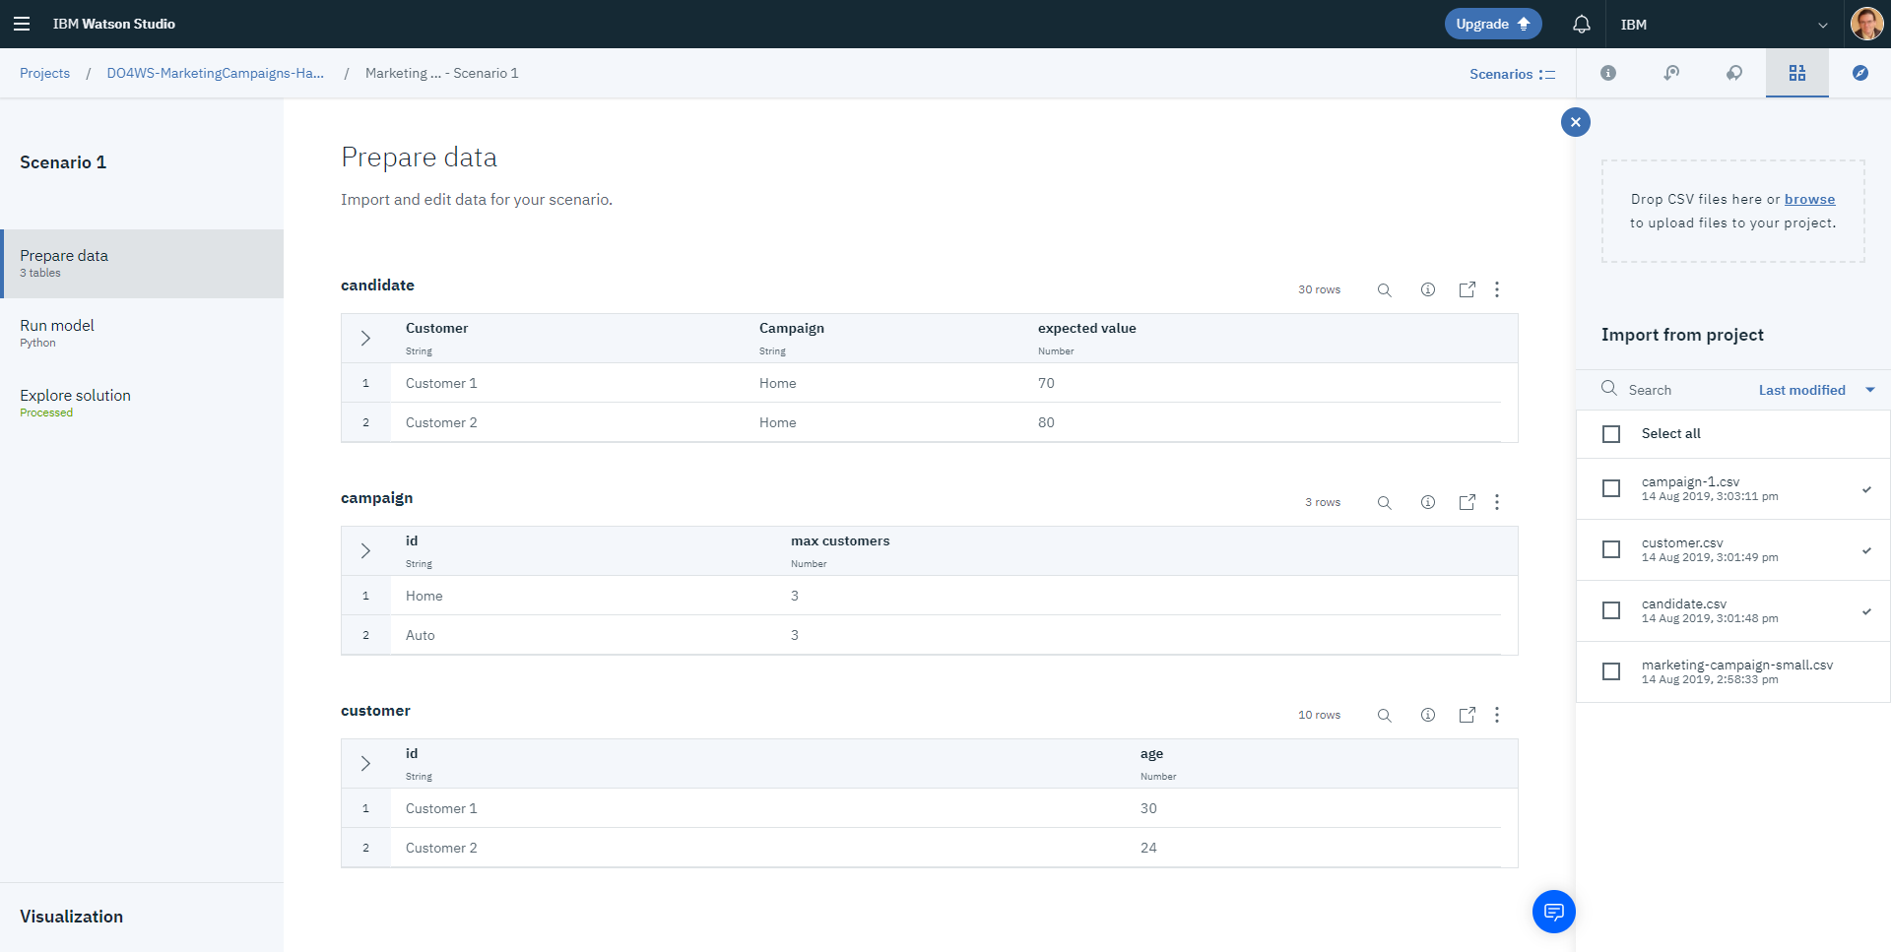
Prepare Data in Model Builder
Add additional data sets to project
Steps supporting model development and validation
Select which data sets to import to your scenario
Preview of imported data

Slide 25
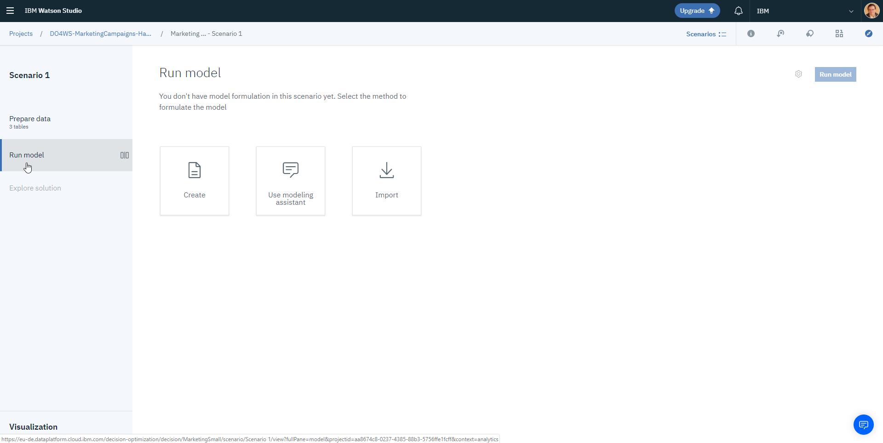
Run Model
Choose to import a model

Slide 26
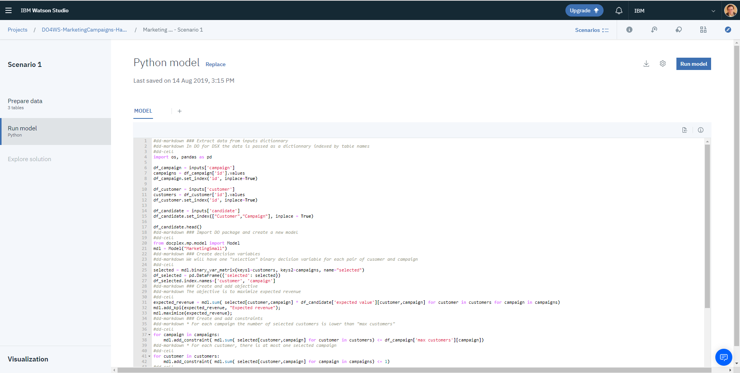
Preview model to be run
Configure the runtime environment
Steps supporting model development and validation

Slide 27
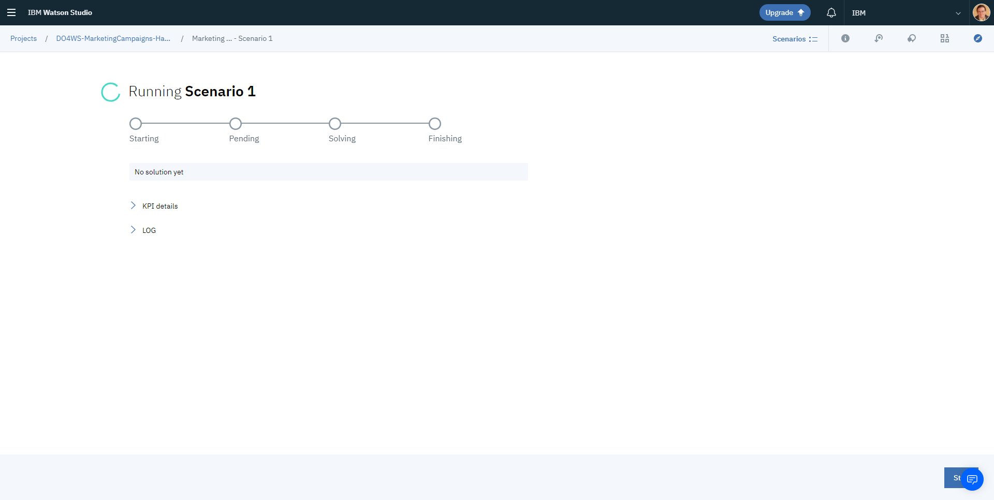
And run…
Live feedback on KPIs and log

Slide 28
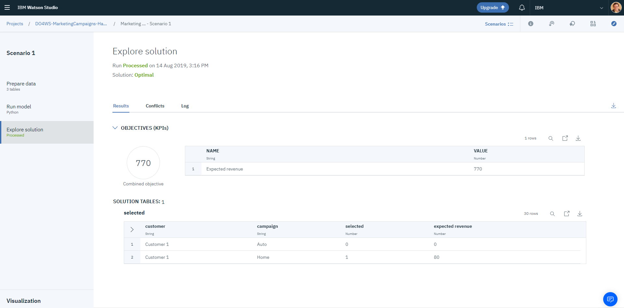
Solution preview
Solution Status
Engine log
Values of different KPIs
Objective value for optimal solution (“Expected Revenue”)
Values of decisions

Slide 29
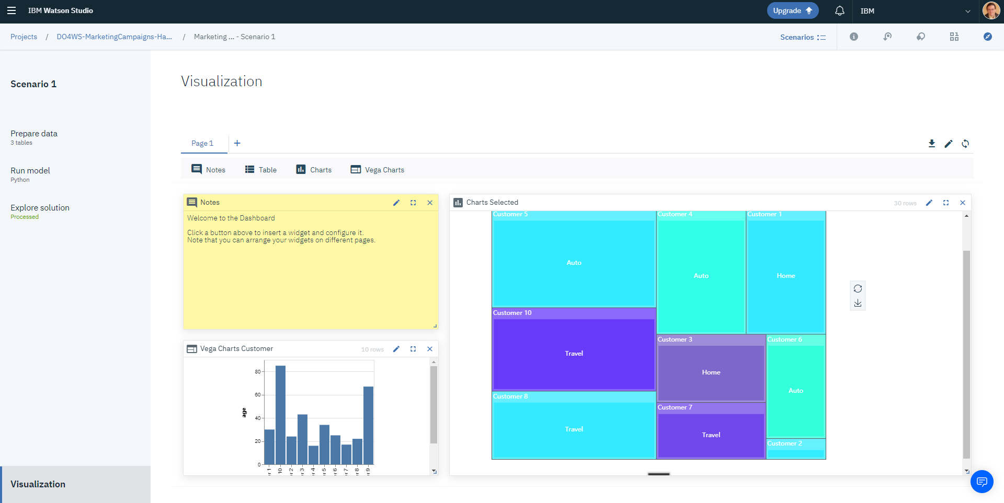
Visualization for model validation
Multi page
Create widgets

Slide 30
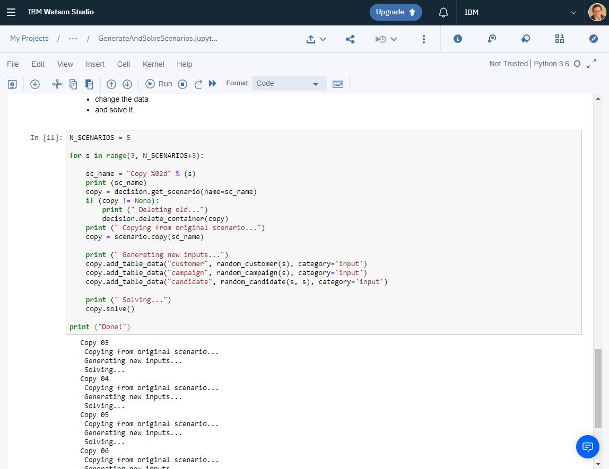
5. Use Python to work with many scenarios
Objectives
In order to validate the model, Business Analysts will want to see the outcome of the model formulation on different scenarios.
A Python Notebook can be used to create some scenarios (e.g. randomly), solve them automatically, and then compare them using your dashboard.

Slide 31
Step 5 tips.
Create a new notebook.
Use dd_scenario Python API: https://pages.github.ibm.com/IBMDecisionOptimization/dd-scenario-api/dd-scenario-client-python/doc/build/html/dd_scenario.Client.html
client = Client(pc=pc, apikey=“xxxxxxxxxxxxxxxxxxx")
decision = client.get_model_builder(name=“MarketingSmall")
scenario = decision.get_scenario(name=“Scenario") decision.delete_container(copy)
copy = scenario.copy(“Scenario Copy”)
copy.add_table_data(“table_name", data_frame, category='input')
copy.solve()
For credentials:
In the More menu More menu icon containing three vertical dots, select Import Project Token. This adds your authorization token in a hidden cell.
From the main home Navigation Menu, select Manage > Access (IAM) > IBM Cloud API keys. Create and copy your API key.
Solution in “GenerateAndSolveScenarios” notebook.

Slide 32
Create N new scenario
Update to random data
dd_scenario Python package provide API to manipulate scenarios.
You can:
Access scenarios,
Create new ones, duplicate,
Access scenario data (input/output etc)
Solve scenario
Solve

Slide 33
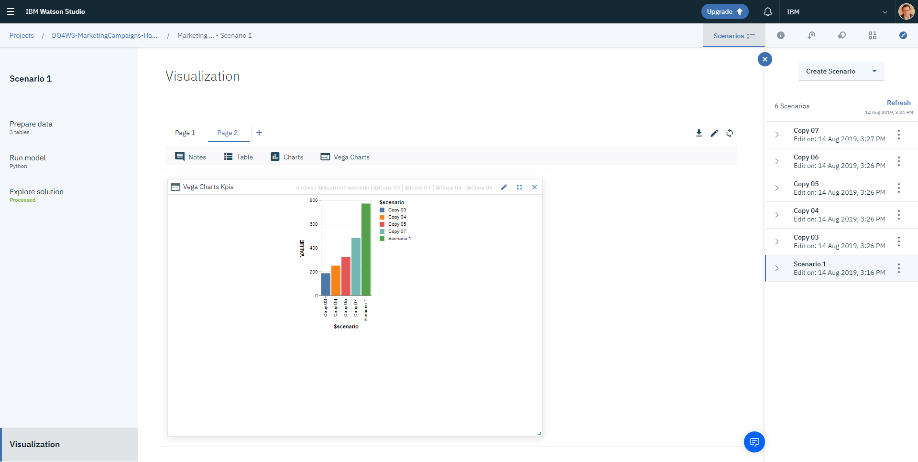
The different scenarios can be compared using Visualization
Compare KPIs over scenarios

Slide 34
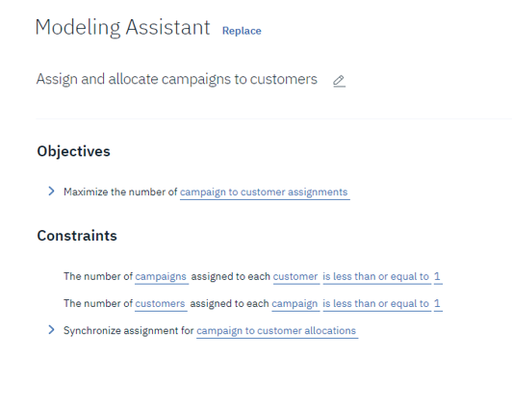
6. Use Modeling Assistant
Objectives
The modeling assistant uses a known domain and your data and guides you over the model formulation process.

Slide 35
Step 6 tips.
Create a new Decision Optimization model.
(or create a new scenario in the model from previous step)
Select data to use.
Formulate model using modeling assistant
Use the Resource Assignment domain Solution in “MarketingCampaignAssignment” model.

Slide 36
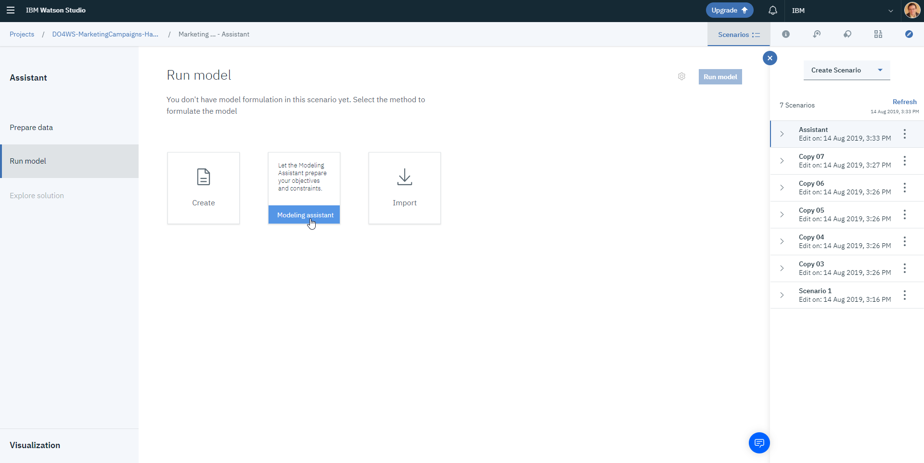
Formulate model using Modeling Assistant
Choose to use the modeling assistant

Slide 37
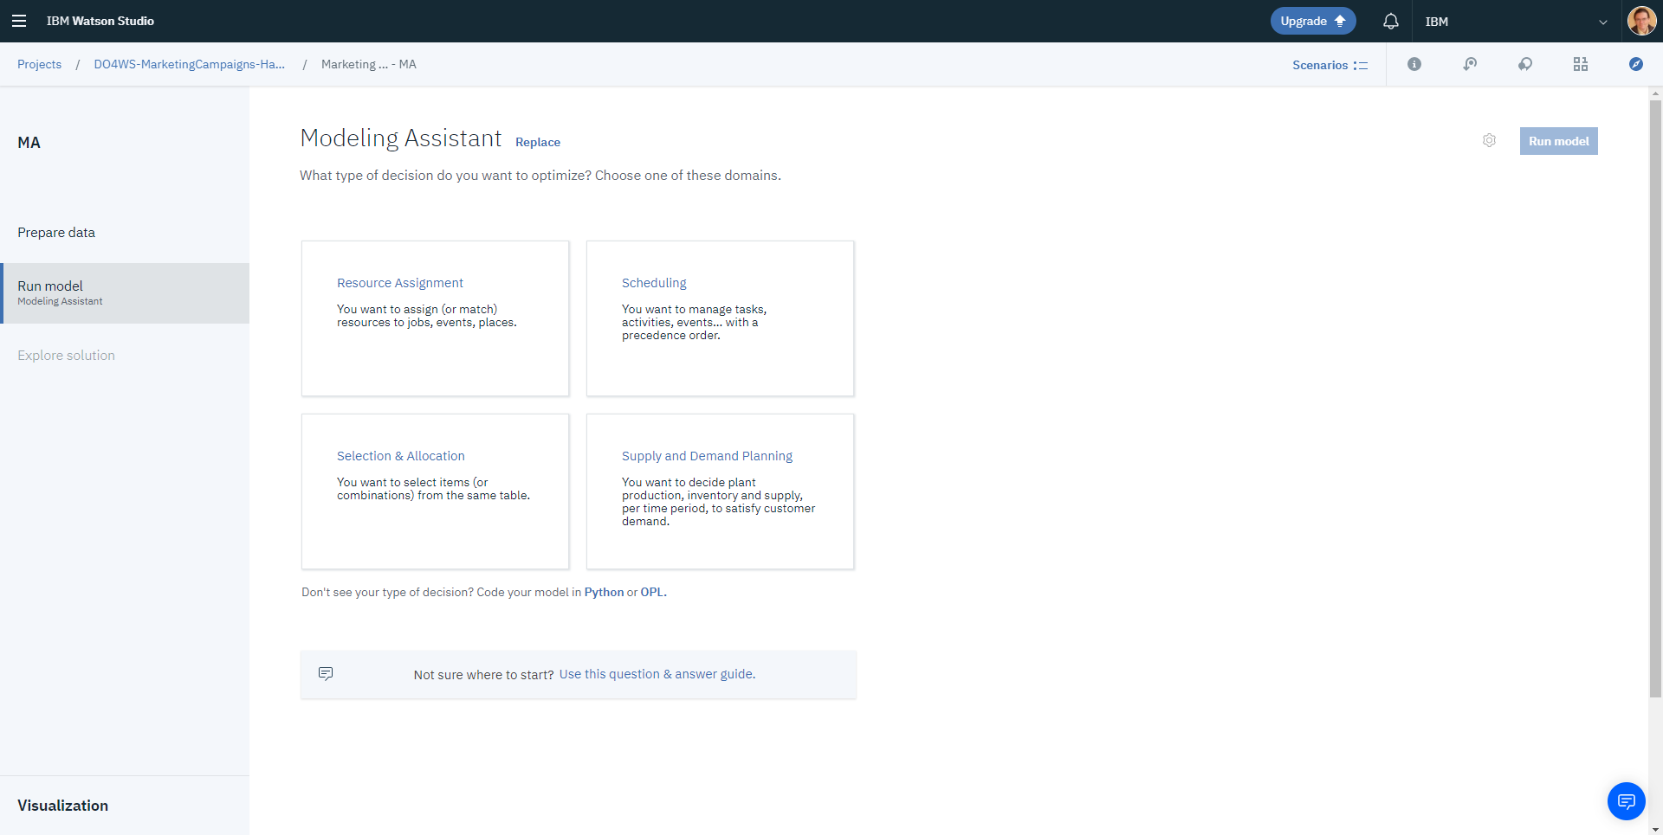
Modeling Assistant Domain Selection
Choose the domain corresponding to the problem you want to formulate.

Slide 38
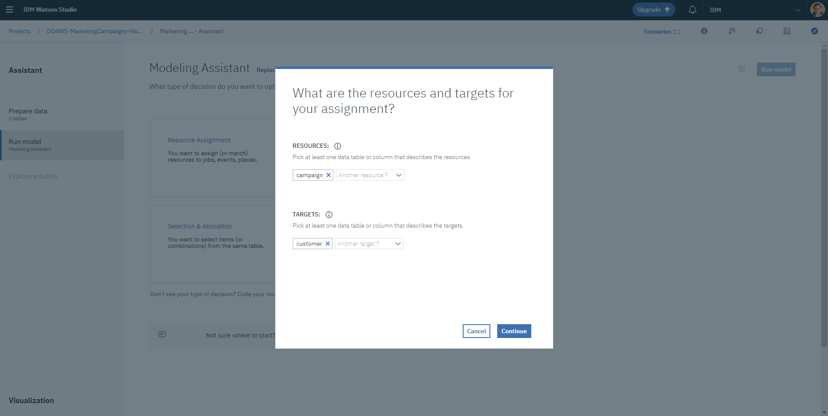
Domain specific intent selection
Based on its analysis of your data, the modeling assistant helps you choose the key concept to be used, e.g. tasks and/or resources

Slide 39
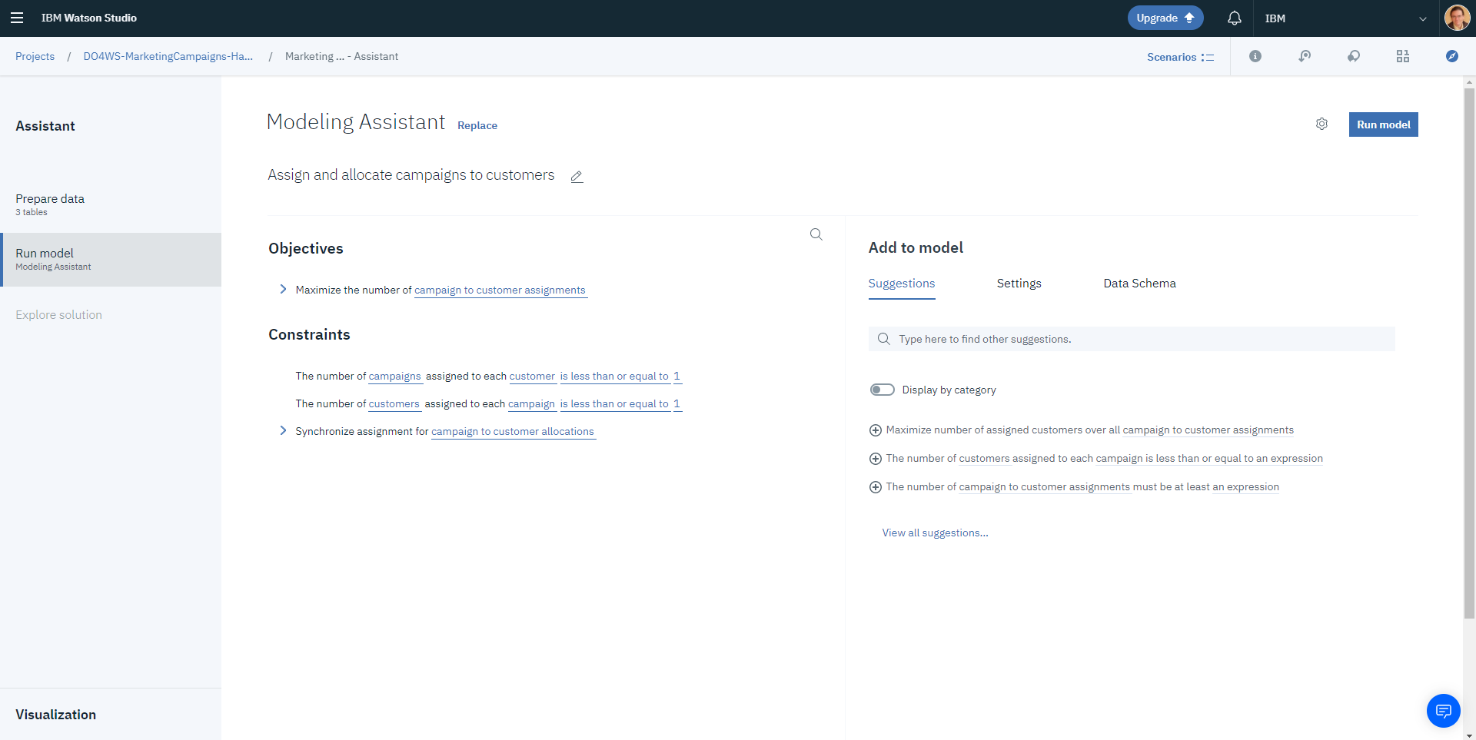
Modeling Assistant main screen
Current formulation of your model

Slide 40
Modeling Assistant main screen
Suggestions of additional constraints and objectives (based on your text input)

Slide 41
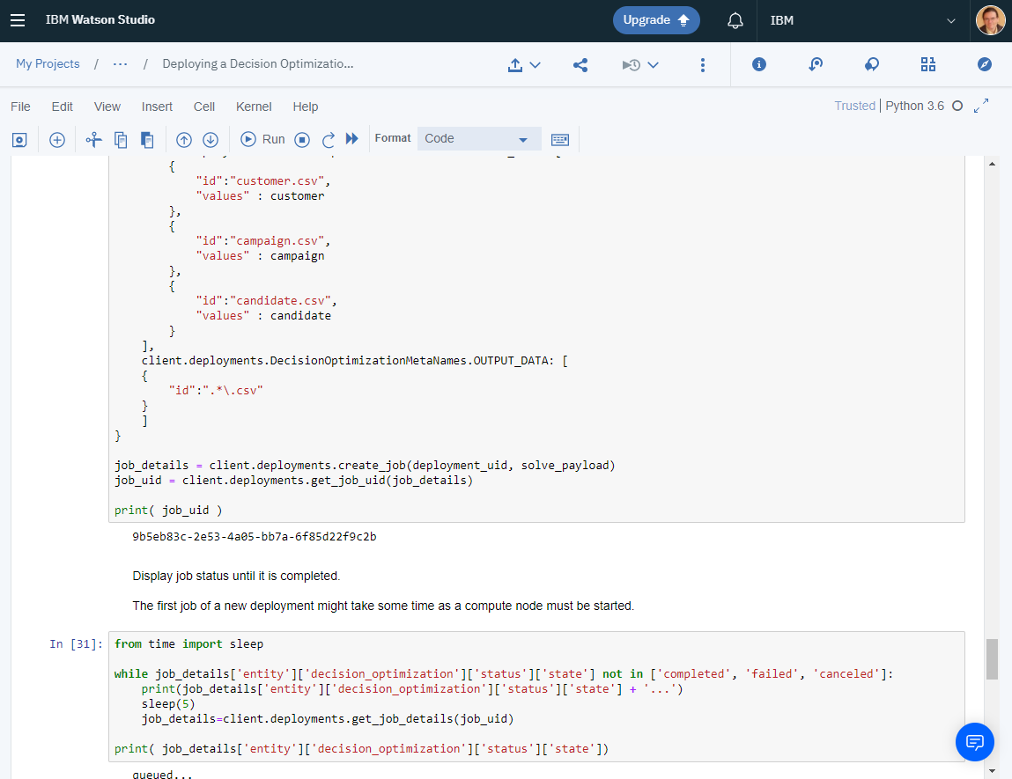
7. Deploy your DO model
Objectives
After the decision optimization model has been created, tested, tuned and validated, it must be deployed so that it can be used in a production application.

Slide 42
Step 7 tips.
Reuse ‘Deploying a Decision Optimization Model’ example notebook from the community
Change the model formulation to be deployed
Change the input data payload for test
The first job takes more time to run as environment is started. Solution in “Deploying a Decision Optimization Model” notebook.

Slide 43
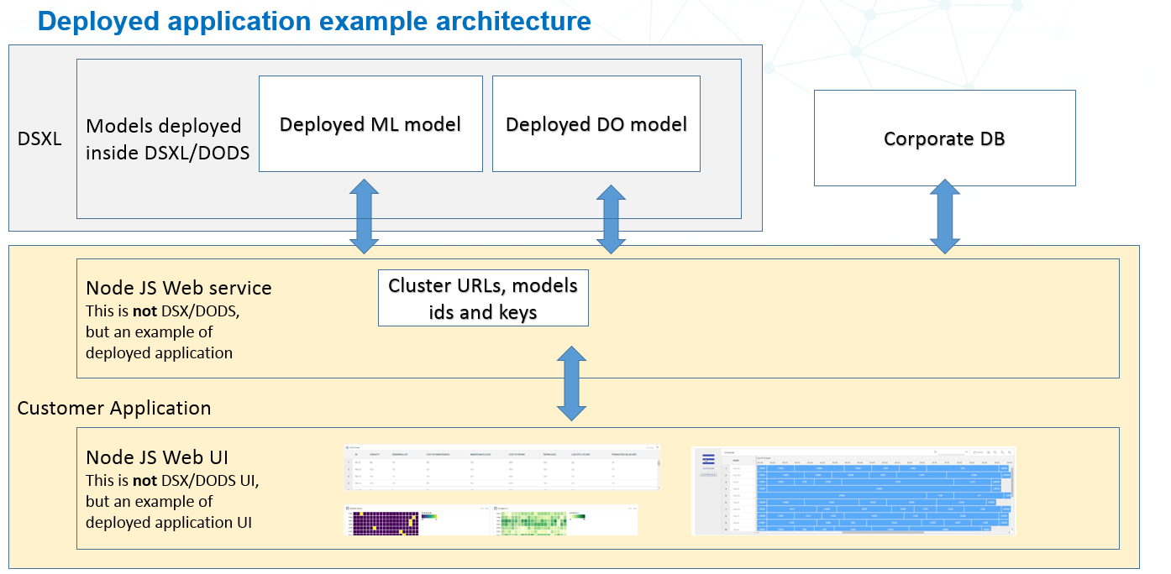
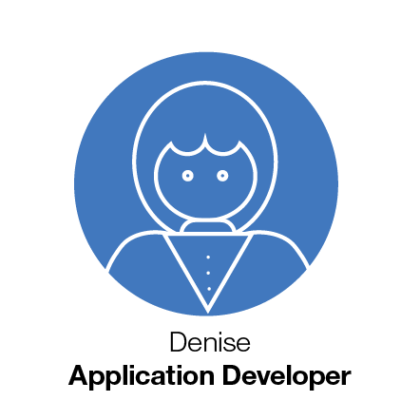
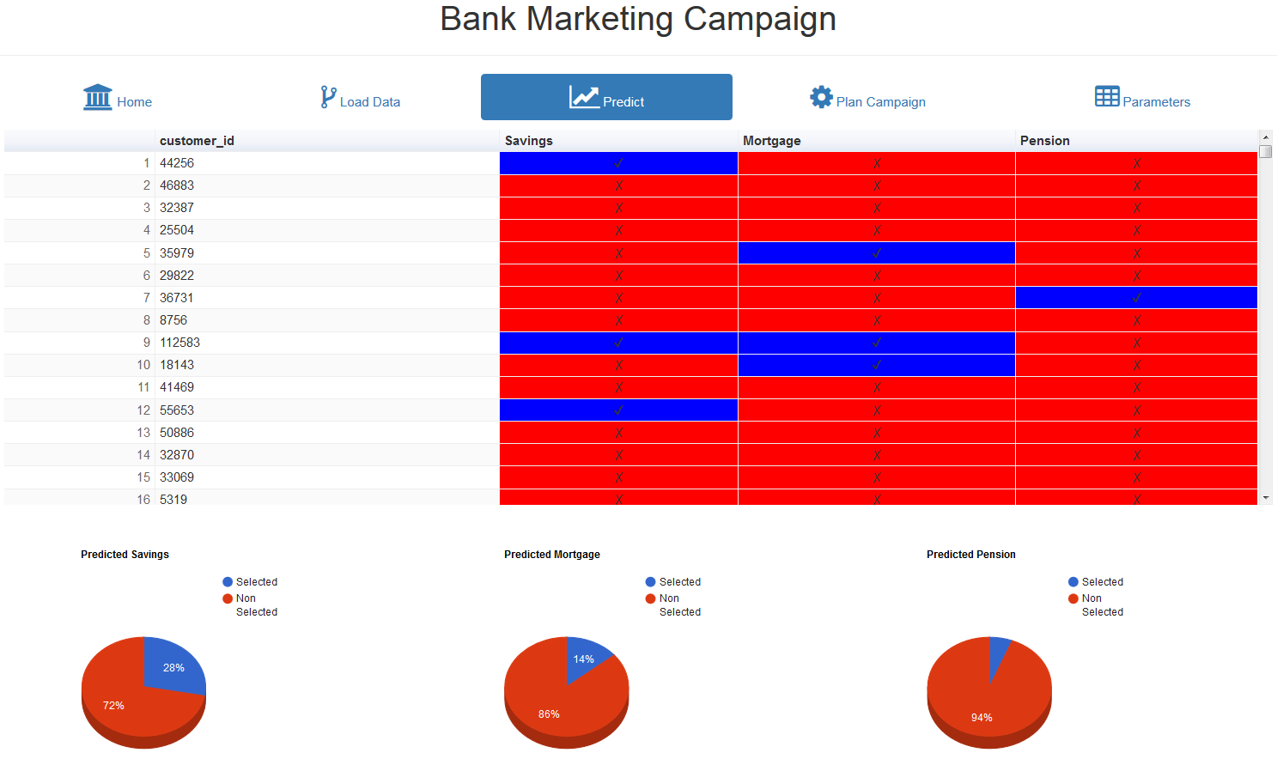
7. Integrate deployed model into business application
Objectives
The deployed predictive and optimization models are associated to a URL to be used for REST API calls and some token/key for authentication.
For deployed Decision Optimization models, an execution service allows to run new jobs with new input data and get solution data.

Slide 44
Step 8 tips.
You can have a look at several examples in:
https://ws-do-ucp-demo-app.eu-gb.mybluemix.net/workspaces/
Source code in:
https://github.com/IBMDecisionOptimization/do-ws-ucp-demo-app

Slide 45
Conclusions
In this Hands-On, you have learnt about each step required to create an application combining ML and DO models integrated in a business application.
While the example was didactically simple, same principles and features apply for bigger models.

